Slide 1



Monitoring, Evaluation, and Reporting (MER) Tool
#BawatBuhayMahalagaSaDSWD

Slide 2


Purpose of the Tool
Who is this for
Designed to store, manage, and track beneficiary, project, and inventory data using an online Google Sheets–based tool.
Intended for Field Office Regional Focals and Monitoring, Evaluation, and Reporting (MER) Focals who are responsible for encoding, managing, monitoring, and validating beneficiary, project, and inventory data using the Google Sheets–based online tool.
#BawatBuhayMahalagaSaDSWD

Slide 3
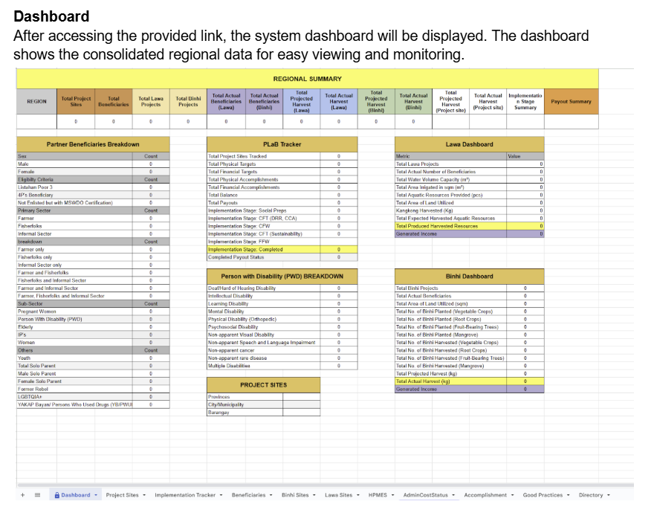
#BawatBuhayMahalagaSaDSWD

Slide 4
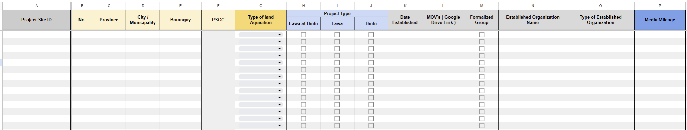
Project Sites
#BawatBuhayMahalagaSaDSWD

Slide 5
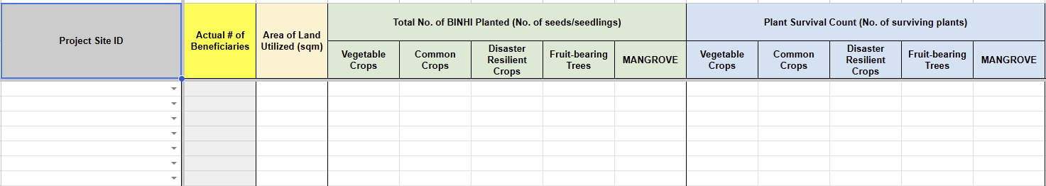
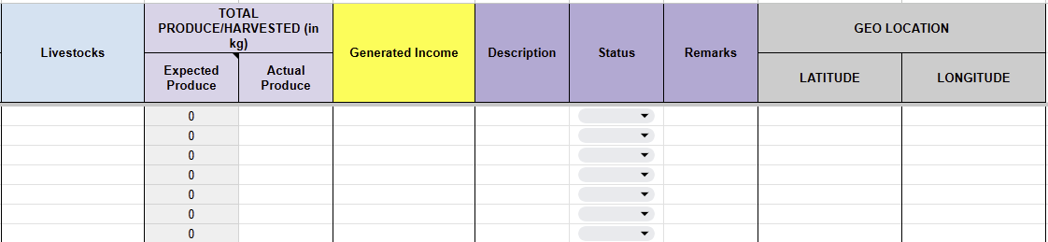
Binhi Site
#BawatBuhayMahalagaSaDSWD

Slide 6
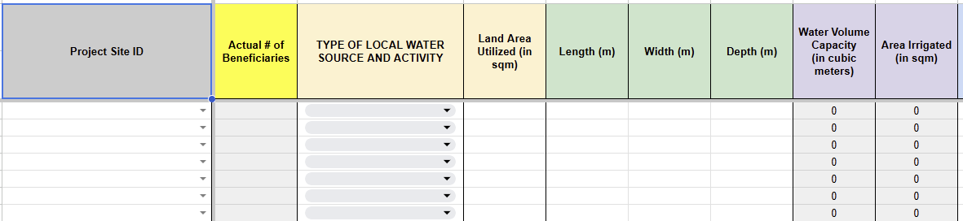
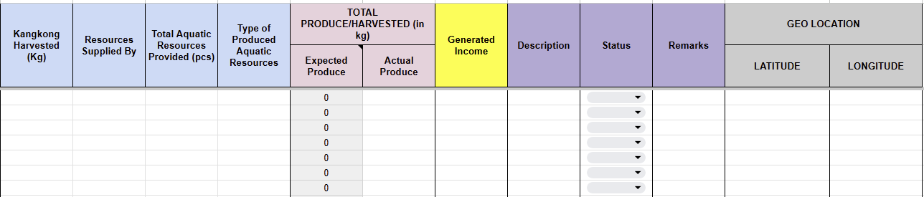
Lawa Site
#BawatBuhayMahalagaSaDSWD

Slide 7
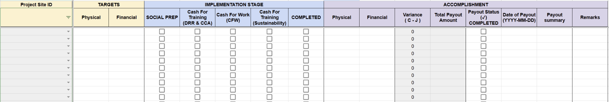
Implementation Tracker
#BawatBuhayMahalagaSaDSWD

Slide 8
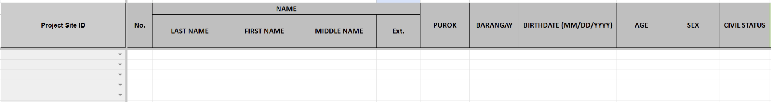
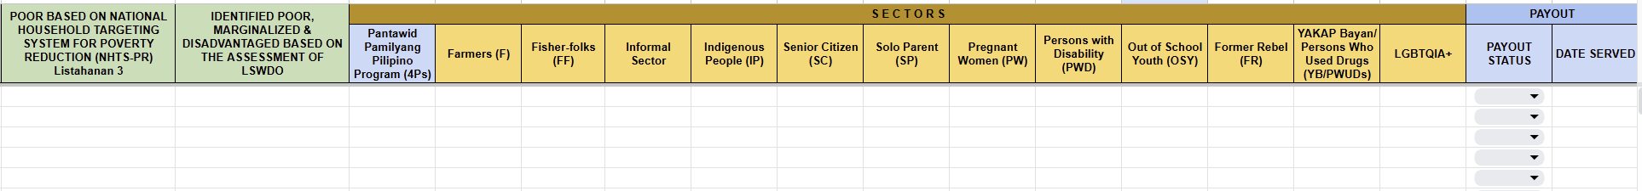
Partner Beneficiary
#BawatBuhayMahalagaSaDSWD

Slide 9
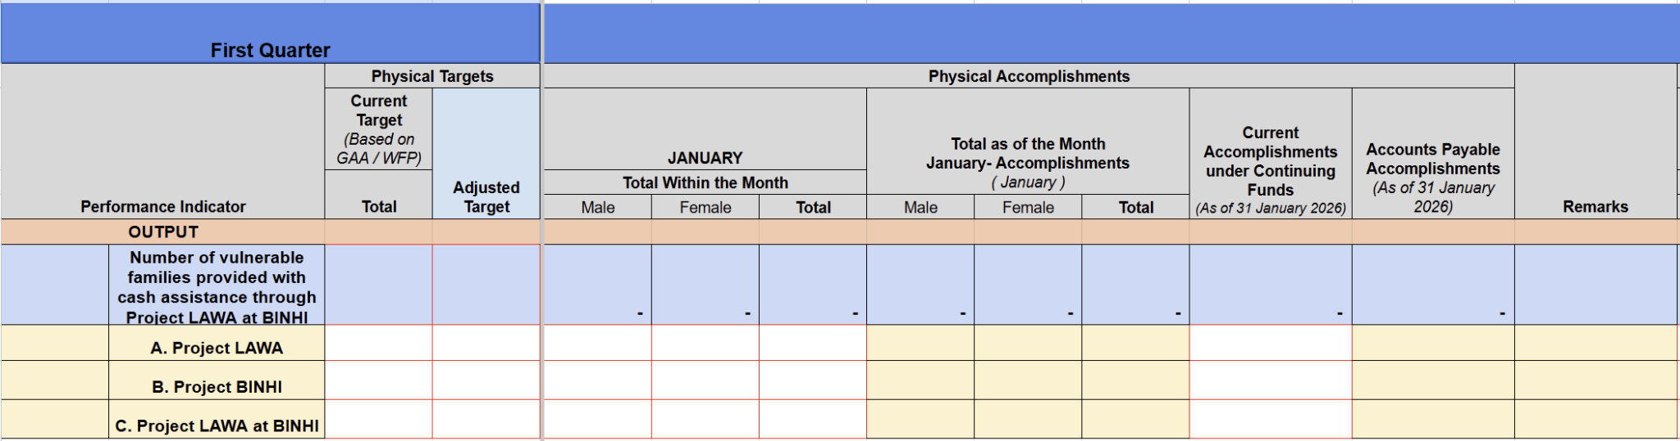
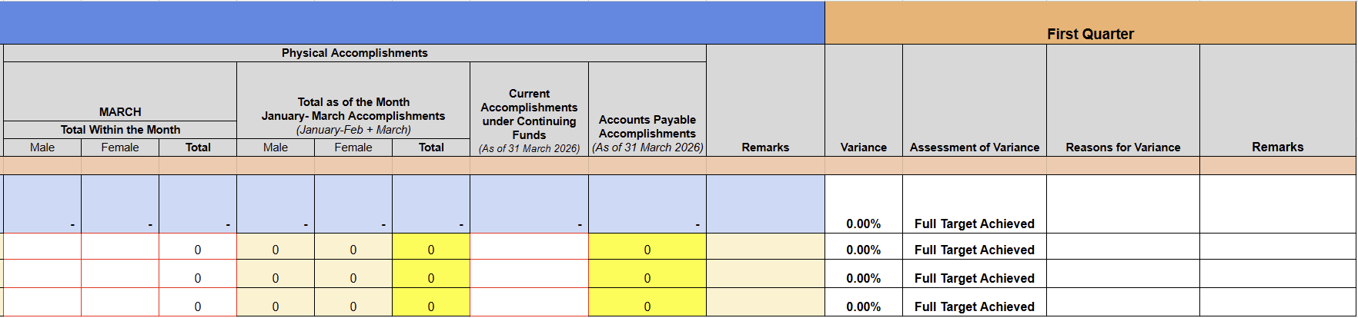
HPMES
#BawatBuhayMahalagaSaDSWD

Slide 10
THANK YOU!
Questions and Discussion
#BawatBuhayMahalagaSaDSWD

